Slide 1
Comprehensive Lifecycle for Assuring System Safety - CLASS
Dependable Computing LLC
Contract NNL13AA08C
Friday the 13, 2014

Slide 2
About Dependable Computing
Founded in 2009 by John Knight
Provision of complex engineering services:
  Safety case development and training
  Formal specification and verification
Customers include:
  U.S. Navy
  U.S. Air Force
  DARPA
  NASA
  FDA
  NRC
  Toyota ITC, USA

Slide 3
About Dependable Computing
John C. Knight, Ph. D.
M. Anthony Aiello, MCS
A. Benjamin Hocking, Ph. D.
Kimberly S. Wasson, Ph. D.
Jonathan C. Rowanhill, Ph. D.

Slide 4
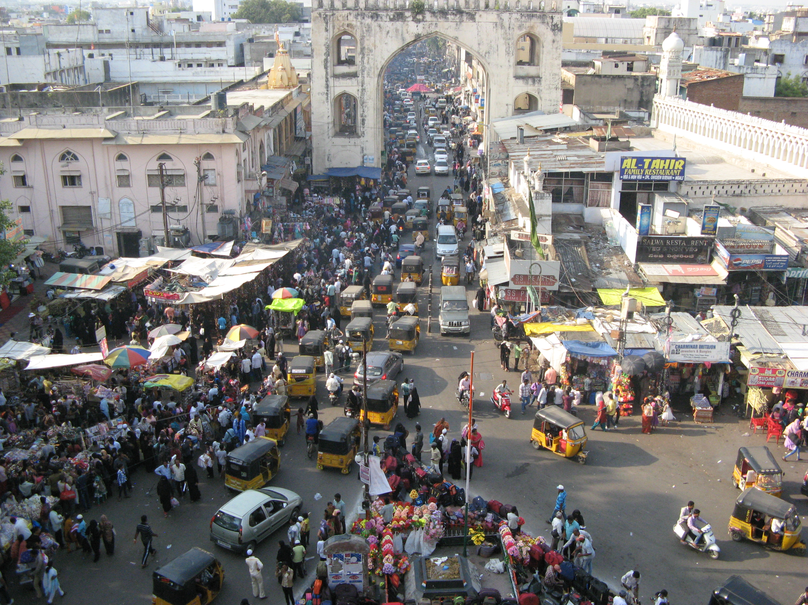
About Dependable Computing
Secure Facility
For those who have not been to Charlottesville lately

Slide 5
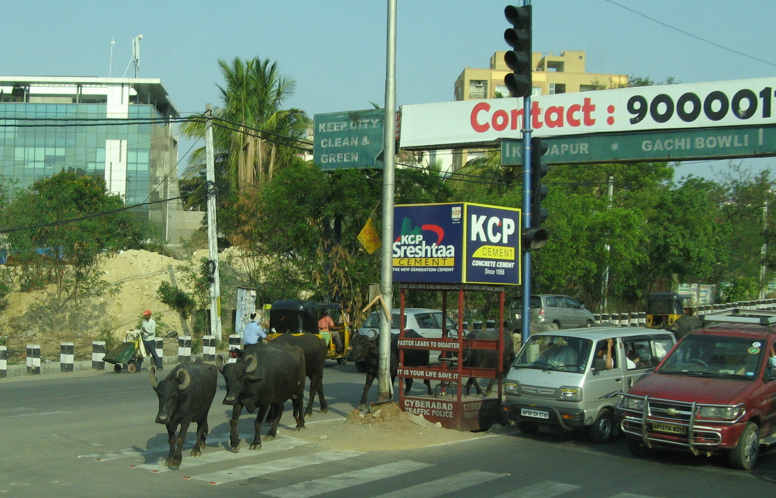
About Dependable Computing
New Staff
For those who have not met our new staff….

Slide 6
CLASS Project Overview
End of first year of project
Technical goal:
  Support for entire system lifecycle
  Focus/basis: system safety case
Prototypes:
  Prototype 1 after six months
  Prototype 2 at end of first year (subsumes P1)
Focus on prototype 2 in this presentation
Scope:
  Not replacing/rebuilding existing safety techniques
  Enhancing/refining as necessary to support lifecycle
Summary here – details in Prototype 2 papers

Slide 7
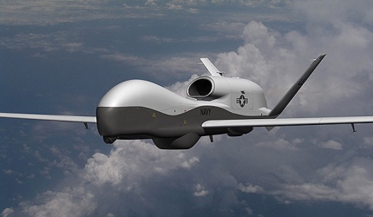
CLASS Vision
Creation?
Assessment?
Monitoring?
Repair?
Aviation system lifecycle support based on safety-case technology
From system concept to retirement
Synergy:
  System
  Safety case
Navy MQ-4C Triton Broad Area Maritime Surveillance Unmanned Aircraft System

Slide 8
Lifecycle Setup

Slide 9
Meta Process
No single process for all aviation systems
Meta process:
  Drawing from resource repository (CRR)
  Instances for specific systems of interest
  Meta and instance processes remain synchronized over time

Slide 10
Instantiation & Safety Information Repository
Community Resources
Access Protocols
Instance Process
Instance Resources and Records
Lifecycle Resources

Slide 11
Resource Repository
Lifecycle support resources
Temporal:
  Propagate/monitor change
  Respond to change/defects
  Local system to others
  Others to local system
  Pull vs. push

Slide 12
Safety Case Creation

Slide 13
Theoretical Foundations
Creation challenges:
  Separate/uncoordinated development
  What to argue, how to decompose it, how to organize it
  Scale – system, stakeholders, contexts, etc.
Techniques include Assurance Based Development (ABD)
CLASS problem orientation:
  Get the problem statement right first
  Key to getting the solution (requirements)
  Key to knowing that the solution is the right one (assurance case)

Slide 14
Problem Frames
Jackson’s Problem Frames:
Observations by Jackson:
  “Big problems are made up of smaller ones”
  “Many smaller ones recur”
CLASS exploits this regularity to guide decomposition (and composition) of assurance arguments
Essentially problem described with problem frames determines argument structure
“Problem frames characterise classes of problems that commonly occur as sub-problems of larger, realistic, problems. The intention is to analyse realistic problems by decomposing them into constituent subproblems that correspond to known problem frames. This analysis guides the decomposition.”

Slide 15
Evidence Integration
Evidence derives from many sources
Independent safety analysis is typical but problematic
All evidence:
  Is “specified” by safety case
  Has to “integrate” with safety case
CLASS defines necessary interfaces

Slide 16
Safety Case Assessment

Slide 17
FAA Certification Considerations
FAA roles:
  Airborne vs. ground vs. linked systems
  Regulator vs. acquirer
Introduction of new technique:
  Lack of familiarity leads to extreme conservatism
  Requirement for continuous involvement, outset on
  Same conditions as present, e.g., no extraneous fn.
  Implementation of levels A – D
  Coordination with other countries, ICAO initiatives
  Switch to Organization Designation Authorization (ODA)
Important/Orthogonal Considerations

Slide 18
Meta & Instance Processes
Meta process:
  Filter model
  Regulation constraints
  Process constraints
  CRR services
Lifecycle assurance requires:
  Integration of FAA initiated reviews
  Updates as system evolves
  Safety case repair

Slide 19

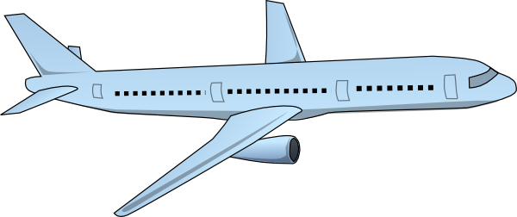

The Filter Model Of Assessment
Filter
Good
Assessment Process Flaw
Bad

Slide 20
Assessment Analysis Model
Assessment Is A “Safety Critical” System
Hazard Identification
Fault Tree Analysis
Assessment
Apply Safety Engineering To Assessment
FMECA
Empirical Studies

Slide 21
Assessment Analysis & Delegation
Assessment
Claim About Filter Properties
Assessment Needs Assurance
There Has To Be A Rationale For Belief In This Claim
Assessment “Safety” Case
Practical Implementation Of Assessment Filter
Assessment
Filter
Delegation
Assessment
STANDARDS
Filter Model Motivates Standards
System
Decision
Evidence
Stakeholders
(Perhaps A Regulating Agency)
Developers

Slide 22
System Monitoring

Slide 23
Safety Condition Monitoring
Why? Because:
  Safety case depends upon assumptions
  Safety case modularity relies upon “contracts”
  Any violation could undermine the safety claim
  See the Nimrod report (which only covers this partially)
So what to do?
  Active, comprehensive monitoring
  Entire state including:
    Operational contexts
    System state
    Maintenance
    Etc.
Need Not Be In Subject System
Recall, other possibilities to consider:
Discovery of flaws in safety case (argument, evidence, etc.) after deployment
Relevant issues arise in other systems

Slide 24
Operational Monitoring
Safety case includes:
  Assumptions
  Contracts
Violations threaten safety claim
Assumptions arise in:
  System operation
  System context
  System maintenance
  Etc.

Slide 25
Monitoring
Example
Violation of a monitored assumption
Specification of Required Maneuver Performance
What happens if this is violated in practice?
Monitor this assumption at
run-time

Slide 26
Monitoring
Impact of Violation
Scope rules in GSN for assumption and context are overbroad
Here is the assumption
This is not helpful for directing repair
Here is its scope

Slide 27
Monitoring
Metadata to Indicate Assumption Scope
Our solution: use metadata to “tag” elements
Here is the assumption
These are the areas that need repair and reassessment
Relevant here
Relevant here

Slide 28
Safety Case Repair

Slide 29
System and Safety Case Repair
Determine how the system will be updated
  Increase performance?
  Adjust system to account for lower performance?
Update impacted elements
  Threat evaluation logic
  Maneuver selection logic
Update impacted evidence

Slide 30
Evidence Repair
Updated requirements for impacted claims
Updated hazards
Updated requirements drive updated hazard assessment
Revised hazards drive updated safety assessment
Safety case drives the repair process
Restrict repair to what is essential to re-establish basis for safety
Revised/new hazards
Revised safety assessment

Slide 31
Reassessment and Repair
Reassess the safety of the system
  Review all of the new evidence
  Ensure that updated portions of the argument are
    Consistent with all in-scope assumptions
    Valid in all in-scope context
Repair the filter
  This occurrence implies a failure in the certification process
  Check the filter for weakness
  Repair as needed

Slide 32
Meta CLASS Update
Defects detected in:
  Local instance
  Other instance
  CRR
Need to:
  Inform
  Update resources
  Update instances

Slide 33
CLASS Vision

Slide 34
Recall - CLASS Vision
Aviation system lifecycle support based on safety-case technology
From system concept to retirement
Synergy:
  System
  Safety case

Slide 35
CLASS Instance

Slide 36
General Topics

Slide 37
Lifecycle Literature Survey
Survey of reported lifecycle concepts, experiences, applications, etc.
Goal was to learn what CLASS needs that is not currently there
Several potential improvements identified:
  Refined subphase to enhance ACMP
  Addition of document lifecycle
  Lifecycle linking of metaCLASS and instanceCLASS
  Support for system disposition within metaCLASS and instanceCLASS
  Resource repository (CRR) lifecycle

Slide 38
Safety Case Toolkit
Safety-Case Organization
CRR -> SIR Process/Resource Import
SIR-> CRR Process/Resource Update
Lifecycle Notifications

Slide 39
Safety Case Toolkit
Assumption & Context Association
Ownership & Assessment Status
Monitor Association
Lifecycle Subprocess Association & Status

Slide 40
Safety Case Toolkit
Change <-> Trigger Association
Directed Assessment
Version Control & Lifecycle Transparency

Slide 41
Prototype 2 Summary

Slide 42
Plans for Year 2
Prototype 3 Goal: All pieces of CLASS present
  metaCLASS + instanceCLASS
  CRR + SIR
  Begin running a major safety-case effort using CLASS
Monitoring
  CRR components for monitoring
Lifecycle enhancements
Repair
Empircal studies

Slide 43
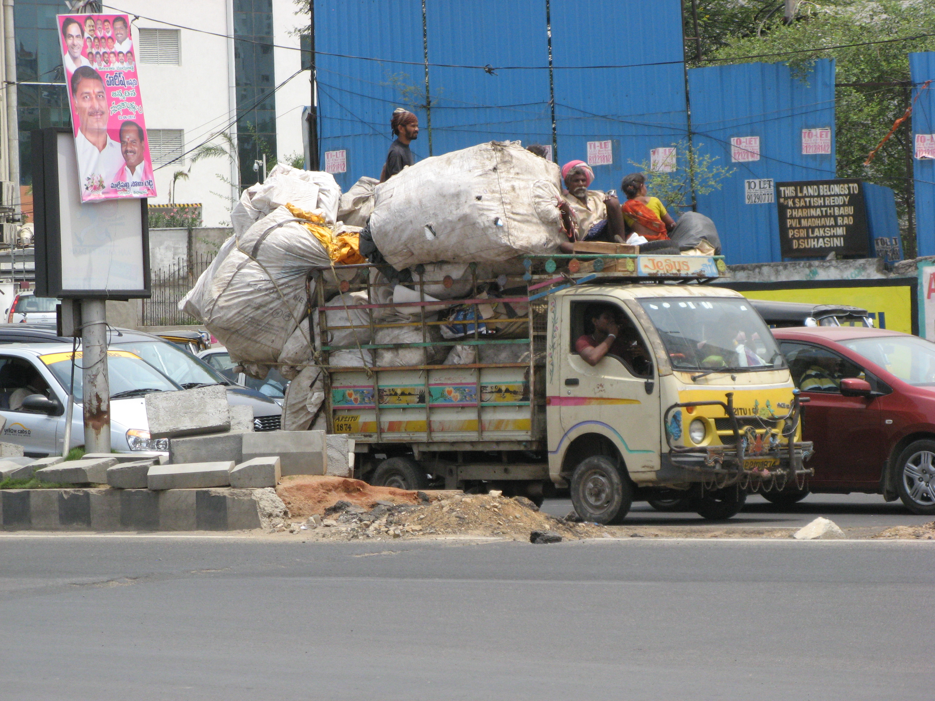
DCi Travel Facilities

Slide 44
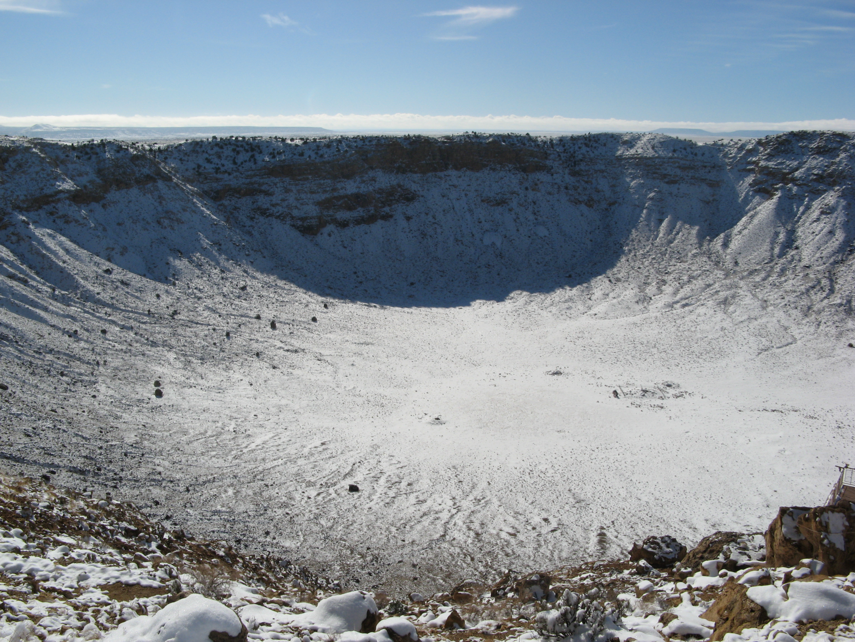

Slide 45

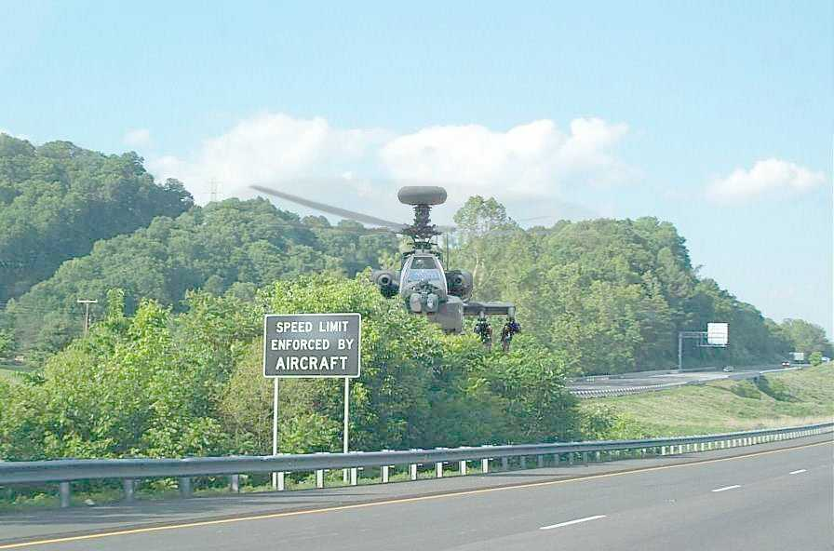
U.K.
U.S.
Questions?

