Slide 1
Comprehensive Lifecycle for Assuring System Safety – CLASS
Final Project Report And Recent Results
John Knight and Jonathan Rowanhill
Dependable Computing LLC
Contract NNL13AA08C
April 27, 2016

Slide 2
Presentation Status
This is public presentation of technical material developed jointly by three organizations
The presentation is a citable communication in the event that anybody attending chooses to reference, quote or otherwise use any of the ideas included

Slide 3
Team Members
Dependable Computing:
  John Knight
  Jonathan Rowanhill
  Tony Aiello
University of Virginia:
  John Knight
  Patrick McGee
  Jian Xiang
Barron Associates:
  Alec Bateman
  Neha Gandhi
  Jared Cooper
And of course……

Slide 4

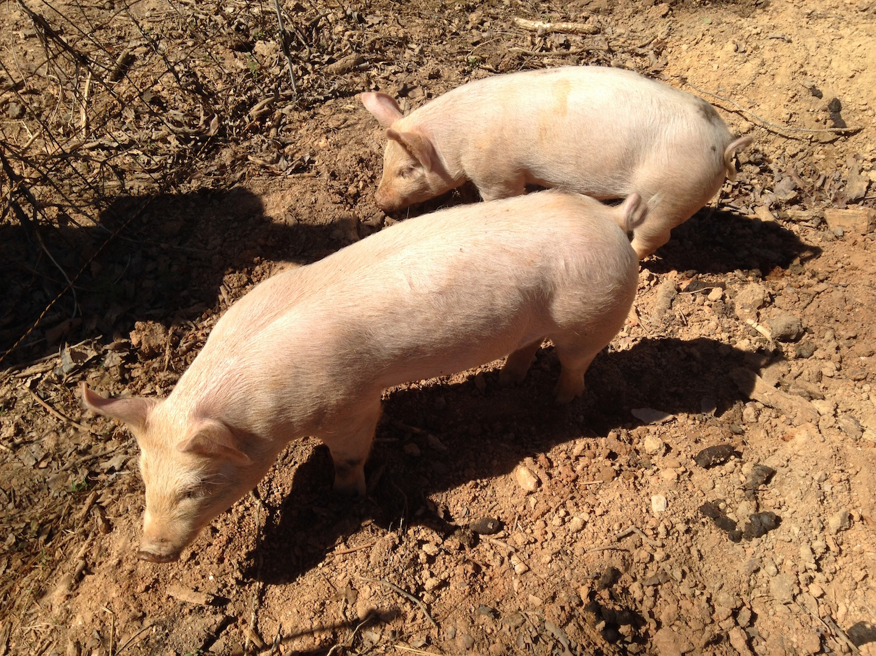



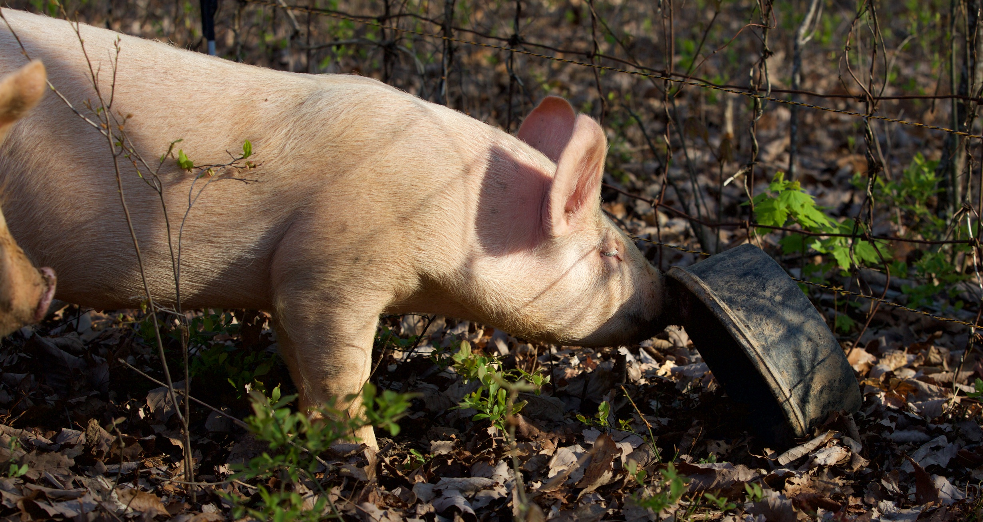
Our Interns

Slide 5
Presentation Outline
CLASS project overview:
  Progression of concept development
Recent results:
  Domain arguments:
    Elicitation
    Conclusions and observations
  Empirical studies:
    Application of latest CLASS concepts
    New ideas in arguments and process
  Rationalized standards:
    Standards as a technical focus
  Expert judgment in assurance cases:
    Judgment arguments
    Annotated bibliography

Slide 6
CLASS Overview

Slide 7
Evolution Of CLASS
Assurance Based Development
CLASS Phase 1
ABD Across Lifecycle
CLASS Phase 2
Encode Best Practices
CLASS Phase 3
Domain Driven
Synergistic development of system & assurance case
Success cases
Process synthesis
CLASS Expertise
Argument Expertise
Synchrony
Domain Expertise
Domain Arguments
Domain Processes
Meta CLASS Repository
Argument Templates
Update messages
Expert Repositories
DCi, York, etc.
Argument Templates
Processes (BPMN2)
Guidance
Update Messages
Domain Communities
Engineering Experts
Argument Experts
Argument Templates
Processes (BPMN2)
Wiki Content
Releases to Repos
Configuration
Instance CLASS
Configured from Meta
CLASS Project
Configured from Meta
Configuration
Empirical Study
Expert Assessment
Expert Assessment
System Community
A system is a highly specialized domain
Instance Repository
All data on system
Project Data
All data on system
Monitoring
System in Operation
Monitoring
System in Operation
Process logs, events
Monitoring
System in Operation
Process logs, events
Communities
Content Generation
Workflow
BPMN2 Processes
Filter Model
For Certification
Workflow
BPMN2 Processes
Rationalized Standards
Expert Judgement

Slide 8
CLASS Phase 2
Changing State Over Lifecycle
System/Safety Case Synchrony
Continuous Monitoring
Assurance Analysis

Slide 9
CLASS Phase 2 Instantiation
CLASS Resource Repository - CRR
CRR Access Protocols
Elements of Instantiation
Continuous Recording - SIR

Slide 10
CRR Hierarchy
Multiple CRRs
Generic For All Systems
Local Tailored To Domain
Instantiation To Support Systems

Slide 11
CRR Update Mechanism
Resources Of All Types
Instantiation Hierarchy
Active Update Mechanism
One Focus Of Synchrony Mechanism

Slide 12
CLASS Phase 2 Operation
Safety Information Repository

Slide 13
CLASS Phase 2 Process

Slide 14
BPMN2 Example

Slide 15
Monitoring Concept
Predications
And
Assumptions
Examples:
Component failure rates
Component performance parameters
Human performance limits
Process conformance
Maintenance activities
Invariants
State & Process
Violations Could Defeat Safety Argument
Monitor Assumptions
State & Process
Tailoring:
Monitoring & Alerts
Not System Safety Requirements

Slide 16
Monitoring For System
State Recognizer FSM
Sensors Across Lifecycle
Communication
Distributed Timing
Multiple Instances As Needed

Slide 17
CLASS Property Assurance
Filter Model
Product Property Assurance
Process Structure
Direct Evidence
Product
Indirect Evidence
Process
Product Properties

Slide 18
Initial/Early Results
Arguments such as “Fit for Use” unfamiliar to domain experts
Not clear that domain experts saw value in traditional safety arguments
Clear that domain experts have their own “arguments” and processes:
  Hypothesized by many
  Clearly present at Barron Associates and FAA Consulting
Decided to try to capture them

Slide 19
For Example - A Production Safety Case
London Underground Upgrade

Slide 20
Example Safety Case

Slide 21
Example Argument
G4 Effective quality engineering shall be applied throughout the project

Slide 22
How do we prevent this?

Slide 23
CLASS Phase 3

Slide 24
CLASS Phase 3 Philosophy
Early CLASS
Current CLASS
Argument Expertise
Domain Expertise
Domain Expertise
Argument Expertise
Assurance
Assurance

Slide 25
CLASS Phase 3 Enhancements
Driven by empirical studies
CLASS enhanced to include:
  Domain-centric model
    Arguments
    Processes
    Guidance
  Collaborative-development model
  Sharing model

Slide 26
CLASS Phase 3 Mechanisms
Wiki:
  Collaboration
  Iteration
Workflow:
  Elicitation
  Iteration
  Conformance
Filter Model:
  Rationalized arguments
  Expert judgment arguments

Slide 27
Class Phase 3
Changing State Over Lifecycle
Many Product Types
Monitoring all Products and Applied Resources
Assurance Is a Domain Product

Slide 28
Domains Replace Metarepositories
Many Domain Communities
Sharing Published Resources
Systems are Highly Specific Domains

Slide 29


“Domain” Arguments
Experts have beliefs in what will work
Tell me why you “Think you can”.
They also have reasons why they believe these things

Slide 30
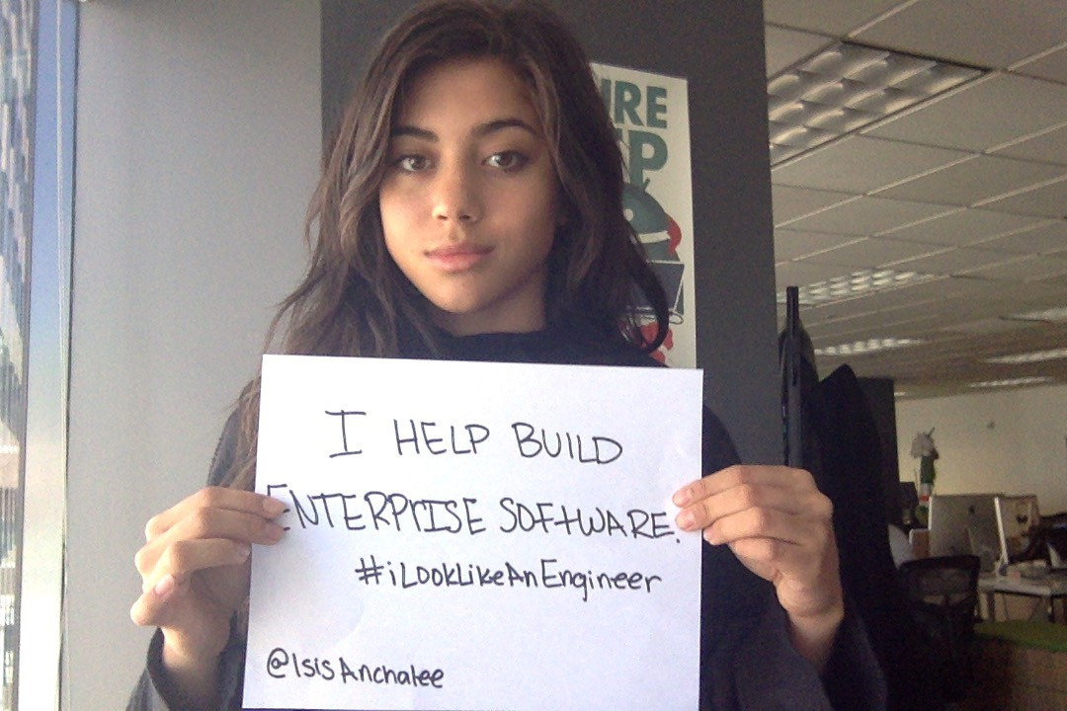
“Domain” Arguments
These beliefs in why things will work are often trade knowledge and not always written down
They are property of a community of knowledge we call a domain
The latest build is of sufficient quality
Unit tests prevent many modification defects
Performance tests at scale will assure the new algorithm can support projected load.

Slide 31
Properties of Domain Arguments
Endogenous vs. Exogenous:
  Endogenous arguments are owned by members of the domain containing the argument’s subject matter
  Exogenous arguments are owned by those not members of a subject matter domain
Synthetic vs. Applied:
  Applied arguments are those that represent the belief models applied by experts to do their work
  Synthetic arguments are those that are synthesized, or written, to assure a property independent of their use in doing work
Domain Arguments are:
  Applied
  Endogenous

Slide 32

Why Domain Arguments?
Stakeholder Hypothesis: Endogenous arguments are living ideas. Exogenous arguments go stale.
Cost Hypothesis: An applied argument is less expensive to explicate and iterate than a synthetic argument is to author and update.
Angler Hypothesis: Why produce endless throw-away ad-hoc assurance? Why not strengthen the arguments of domains so that as the domain is reapplied, stronger assurance continues in the field?
Give an engineer an argument and he has assurance for a day. Teach an engineer to argue and she has assurance for life.

Slide 33
CLASS 3 Manifesto
We are interested in building a safety case from fragmented and immature domain arguments, rather than from a mature but less relevant “traditional” argument.

Slide 34
Empirical STUDY

Slide 35
Empirical Study
Goals
Is the domain-centric model of CLASS Phase 3 feasible?
  What do domain experts want to assure?
  Can one capture domain knowledge?
    Arguments
    Processes
  Can one build meaningful assurance arguments from domain argument fragments?
What are the characteristics of domain arguments and processes?

Slide 36
Empirical Study
Participants
Dependable Computing:
  Role: Assurance experts
  CLASS development and experiment design
Barron Associates:
  Role: Engineering team
  Development of NextCAS system
Ferrell And Associates Consulting (FAA Consulting):
  Role: Approval agency
  FAA certification expertise
Nice Acronym

Slide 37
Empirical Studies
Method
Build part of small system
During iterations on building:
  Capture assurance concerns of the engineering team
  Explicate and improve domain knowledge
  Build coherent assurance arguments
Analyze specimen elements of FAA-like approval process:
  Capture assurance concerns
  Elicit and improve assurance argument
  Analyze role in CLASS filter model
Modify the previously built system:
  Repeat previous elicitation and improvement on changing and new information

Slide 38
Empirical Studies
Initial Setup
  Target system
    NextCAS operating in class A airspace
    Against TCAS equipped aircraft
  System delta
    Update NextCAS reactions to maintain ATC requests for separation
  Assurance goal of system engineers:
    NextCAS suitable for flight test
  FAA DER goal
    Assurance of DO178C conformant peer reviews of requirements

Slide 39
Documents Produced
(Relevant)
Fit-For-Flight-Test Argument
TCAS Model Development
TCAS Work Report
Simulation Based Testing
NextCAS Work Report
NextCAS Validation
NextCAS Flight Test Plan V1, V2
Auditing Peer Requirements Reviews

Slide 40
Argument Elicitation Method
Collect information with minimal interference
Domain experts had been exposed to extensive material on both safety arguments and GSN
Two elicitation procedures:
  Argument Recording: Elicit directly from domain experts using their notations and terminology
  Argument Recovery: Recover from within domain documents

Slide 41
Argument Recording
Fit For Flight Test
  …......
  Batch simulation testing has been used to validate the NextCAS algorithm
    the MIT Lincoln labs encounter scenarios have been used for simulation-based testing of NextCAS
    the encounter scenarios selected for flight testing represents a subset of the test scenarios used for simulation-based testing, and the selected flight test scenarios do not lie near the boundaries of the test space (off nominal conditions encountered during flight testing will not result in the system being evaluated outside the range of conditions considered during simulation-based testing)
    adequate performance was achieved for all encounter scenarios during simulation-based testing, and some additional performance margin was observed for the scenarios planned for flight tests
    simulation-based testing included Monte Carlo testing with random perturbations representative of the uncertainties expected to be encountered in the flight test environment (for example, winds and turbulence represented in the Monte Carlo testing are consistent with acceptable environmental conditions defined for the flight test experiments)
    additional Monte Carlo testing was conducted for the subset of scenarios planned for flight testing (unlikely that any foreseen uncertainties would result in inadequate performance during the flight tests)
  ….....

Slide 42
Argument Recording
Fit For Flight Test (Iteration 1)

Slide 43
Argument Recording
Fit for Flight Test (Iteration 1)

Slide 44
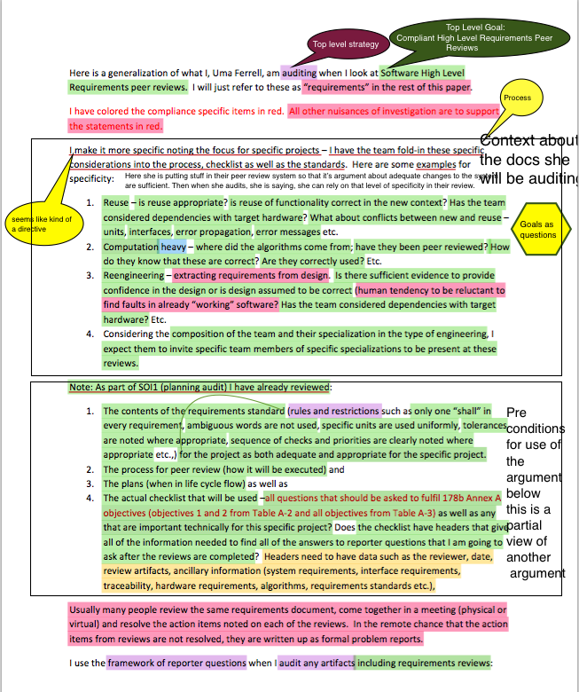
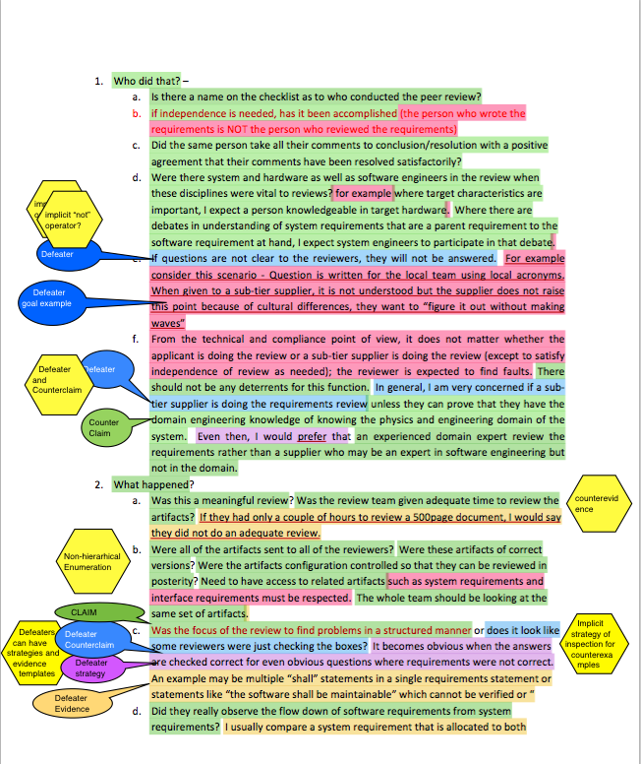
Argument Recovery Process
Document Markup

Slide 45
Argument Recovery from Work Report on TCAS (Initial Markup)

Slide 46
Argument Recovery from Work Report on TCAS (Iteration 1)

Slide 47
Argument Recovery from Work Report on TCAS (Iteration 2)
Useful Specification
Verification
Domain-Oriented
Strategy

Slide 48
Argument Recovery from NextCAS Progress Report (Initial Markup)

Slide 49
Argument Recovery from NextCAS Progress Report (Iteration 2)
”Strategy Functor”
Thinking
Ahead
(tied to plans)

Slide 50
Argument Recovery
Flight Test Plan
Aspect Argument
Aspects are not
for Convenience

Slide 51
Argument Recovery
Flight Test Plan

Slide 52
Argument Recovery
FAA DER Requirements Peer Review Audit
Optional Argument
Structure as Reference
for the Reader
Implemented Argument
Structure

Slide 53
Argument Recovery
FAA DER Requirements Peer Review Audit

Slide 54
Argument Recovery
FAA DER Requirements Peer Review Audit
Defeater
Positive/Negative Pair

Slide 55
Empirical Study
NextCAS Delta
Pending (results in next two weeks)

Slide 56
Empirical Studies
Other Lessons Learned
Argument recorded was real:
  Based on domain experts knowledge, experience, processes
  Referred to after initial recording, indicating “ownership”
Argument recovery was complex:
  Not until 2nd or 3rd iteration of review that domain experts felt comfortable challenging material
  Our suggestions set off discussions that eventually led to their requesting changes
Tempting for argument experts to expand scope of argument – we concluded that this is wrong, at least initially
Domain expert indicated genuine value might accrue when system is headed for certification/flight test approval

Slide 57
Empirical Studies
Results Summary
  What do domain experts want to assure?
    Simulation is fit for flight test
    Flight test will be safe
  Can one capture domain knowledge?
    Arguments: Yes
    Processes: Yes (they wrote plans and process docs)
  Can one build meaningful assurance arguments from domain argument fragments? Yes
    Fit for flight test was built as an overarching argument
    Recovered arguments referred back to it

Slide 58
Empirical Studies
Results Summary
What are the characteristics of domain arguments and processes?
    Flat
    Often tied to process
    Interesting narrative structures
    Interesting strategies
    Constructs such as defeaters

Slide 59
Empirical Studies
Results Summary
CLASS 3 Feasibility
  Arguments can be recovered and improved
  The fragments can be put together
  Operation & Maintenance and Retirement were not considered in this feasibility study.

Slide 60
Rationalized Standards

Slide 61
CLASS And Standards
Standards have:
  Served the community well
  Been criticized by the community
An examination of existing standards reveals:
  Conformance does not imply useful system properties
  A lot of clarification post deployment
  Static content that is difficult to maintain
CLASS benefits from including standards:
  Standards fit well in the framework of the CRR
  Could use existing standards as resources
But:
  Better standard concept suggested by CLASS

Slide 62
Standards And Knowledge
Electronic Data Infrastructure
Standards are knowledge repositories
But they lack:
  Dynamic response to new knowledge
  Rationale for content
  Explicit support for discussion
  Links to experience repositories
Community Knowledge
Support Documents
Standard
[Rationale]
Approved Update
Community Experience
Community & Regulator Analysis
As Standards Are
As Standards Should Be

Slide 63
Rationalized Standard
A Rationalized Standard combines:
Desired property:
  Property desired of conformant systems
  Analyzed by the filter model
Guidance:
  Guidance that, if followed, should yield a system possessing the desired property
Reasoning:
  Reasoning for why conformance engenders belief in the desired property

Slide 64
Existing Standards
Development
Deployment & Use
Always Present During Development
Rarely Recorded and Archived

Slide 65
Practical Application
System Safety Case

Slide 66
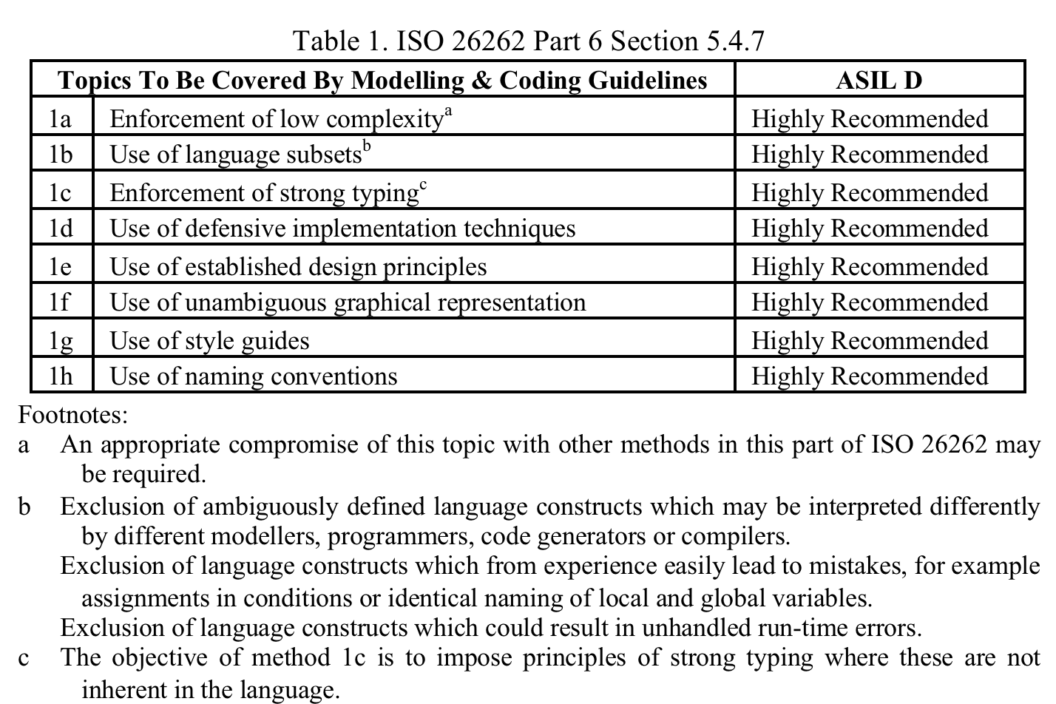
ISO 26262
International Standard ISO 26262:2011
Road vehicles — Functional safety
Part 6: Product development at the software level
ASIL D:
  Automotive Safety Integrity Level D
  Level D is the highest integrity level
No indication of why for anything in the standard
ISO 26262 is confused, disjoint, incomplete …
No, Really,
I Didn’t Make This Up

Slide 67
Arguing Software Correctness
Need a specific property of target system that will be established
Need a clear, concise,
Need an approach that is:
  Integrated
  Comprehensive
Derive guidance from argument

Slide 68
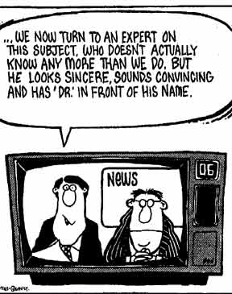
Expert Judgment

Slide 69
Expert Judgment
Expert judgment plays important role in safety arguments
Extensive literature on expert judgment
Many difficulties identified
CLASS includes expert judgment as a mechanism
How could expert judgment be included such that:
  Judgment properly modeled?
  Results support safety claim reliably?
Conducted extensive literature survey
  Annotated bibliography produced

Slide 70

Expert Judgment
Developed new model in earlier work, based on:
  Criticisms in literature
  Models of DER audits and medical diagnosis
New model includes:
  Designated authority-to-operate
  Three-level hierarchic process structure
  Required explicit expertise in:
    Application area
    Proposition area,
Weakness: no assurance of judgment properties
Pathetic

Slide 71
FAA DER Mechanism
Example Judgment Mechanism
Extensive Experience In Industry
Licensing
Involvement
Early & Often
What Might We Learn?

Slide 72
Original Model
Hierarchy
Judgment Expert
Specialists
Technicians
System Specific Details
Authority To Act
Assessment Authority
Instantiation
Interpretations
Specialist To Judgment Expert
Evidence
Technician To Specialist

Slide 73
Elements Of Judgment
Select suitable expert - factors include:
  Predicate knowledge & experience
  Domain knowledge & experience
Form judgment – factors include:
  Data acquisition
  Rationale for conclusion
Elicitation of judgment – factors include:
  Mechanism of judgment delivery
  Scale of judgment in system assurance
Use of judgment – factors include:
  Role in assurance
  Impact of error

Slide 74
Example – Sw. Requirements
Question: are software requirements complete?
  No theoretical or formal answer
  Have to resort to expert judgment
Issues:
  Need domain knowledge/experience:
    Could be known to expert (coincidence)
    Or provided by domain experts (experts relying on experts …)
  Need knowledge of requirements analysis technology:
    Formal models
    Rigorous, informal techniques
    Available literature

Slide 75
Revised Model
Rationale For …
Judgment Case
Filter Model

Slide 76
Conclusions & Future Work
CLASS has evolved:
  From an initial simple extension of Assurance Based Development
  Through a document/process structure
  To a domain/knowledge structure
Empirical studies along the way have guided this evolution
Domain arguments and associated knowledge structure is the core of the current version of CLASS
Next steps:
  Develop deployable version
  Empirical studies of CLASS in production systems

Slide 77
Publications
In preparation:
  Jonathan Rowanhill, John Knight, Domain Arguments in Safety Critical Software Development, to be submitted to: International Symposium on Software Reliability Engineering, Ottawa, Canada (October 2016)
  John Knight and Patrick McGee, A Rigorous Approach To Expert Judgment In The Engineering Of Safety-Critical Software, to be submitted to: International Symposium on Software Reliability Engineering, Ottawa, Canada (October 2016)
Submitted:
  John Knight and Jonathan Rowanhill, The Indispensible Role of Rationale in Safety Standards, submitted to SAFECOMP, Trondheim, Norway (September 2016)
Published:
  Patrick McGee and John Knight, An Annotated Bibliography on Expert Judgment, Technical Report, Department of Computer Science, University of Virginia (April 2016)
  Patrick McGee and John C. Knight, Expert Judgment in Assurance Cases, 10th IET System Safety and Cyber Security Conference, Bristol UK (October 2015)
  John Knight, Jonathan Rowanhill, Anthony Aiello, and Kimberly Wasson, A Comprehensive Safety Lifecycle, ASSURE 2015: The 3rd International Workshop on Assurance Cases for Software-Intensive Systems, Delft, The Netherlands (September 2015)
  John Knight, Jonathan Rowanhill, and Jian Xiang, A Safety Condition Monitoring System, ASSURE 2015: The 3rd International Workshop on Assurance Cases for Software-Intensive Systems, Delft, The Netherlands (September 2015)
  John Knight, Jonathan Rowanhill, Uma Ferrell, Alec Bateman, Neha Gandhi, Integrating An Assurance Case Into DO-178B Compliant Software Development, 34th IEEE/AIAA 34th Digital Avionics Systems Conference (DASC), Prague, Czech Republic (September 2015)
  M. Anthony Aiello, Ashlie B. Hocking, John Knight, Jonathan Rowanhill, SCT: A Safety Case Toolkit, International Workshop on Assurance Cases for Software-intensive Systems (ASSURE 2014), Naples IT (November 2014)
  M. Anthony Aiello, Ashlie B. Hocking, John Knight, Jonathan Rowanhill, Arguing Software Compliance With ISO 26262, International Workshop on Assurance Cases for Software-intensive Systems (ASSURE 2014), Naples IT (November 2014)

Slide 78

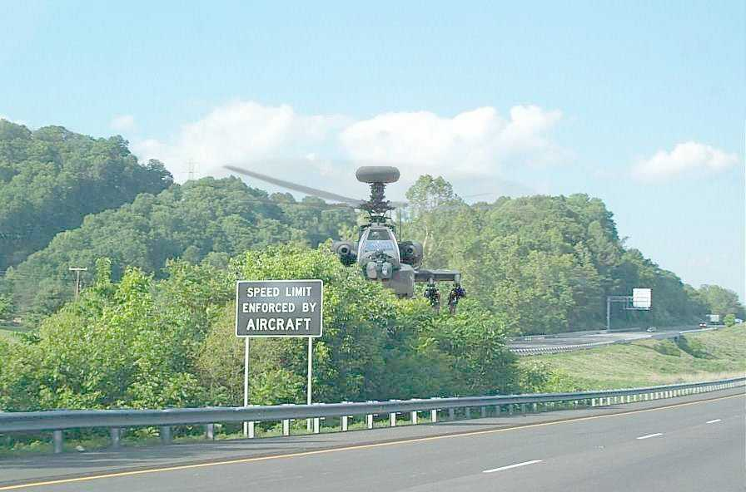
U.K.
U.S.
Questions?

Slide 79

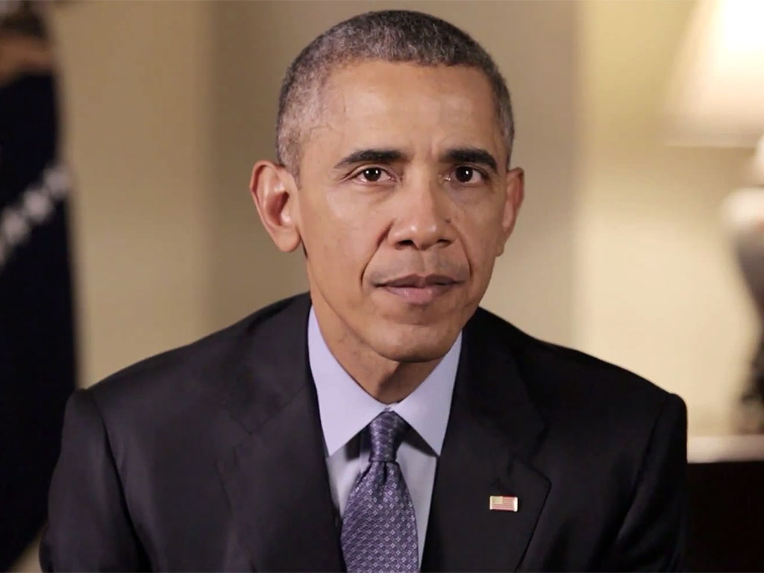
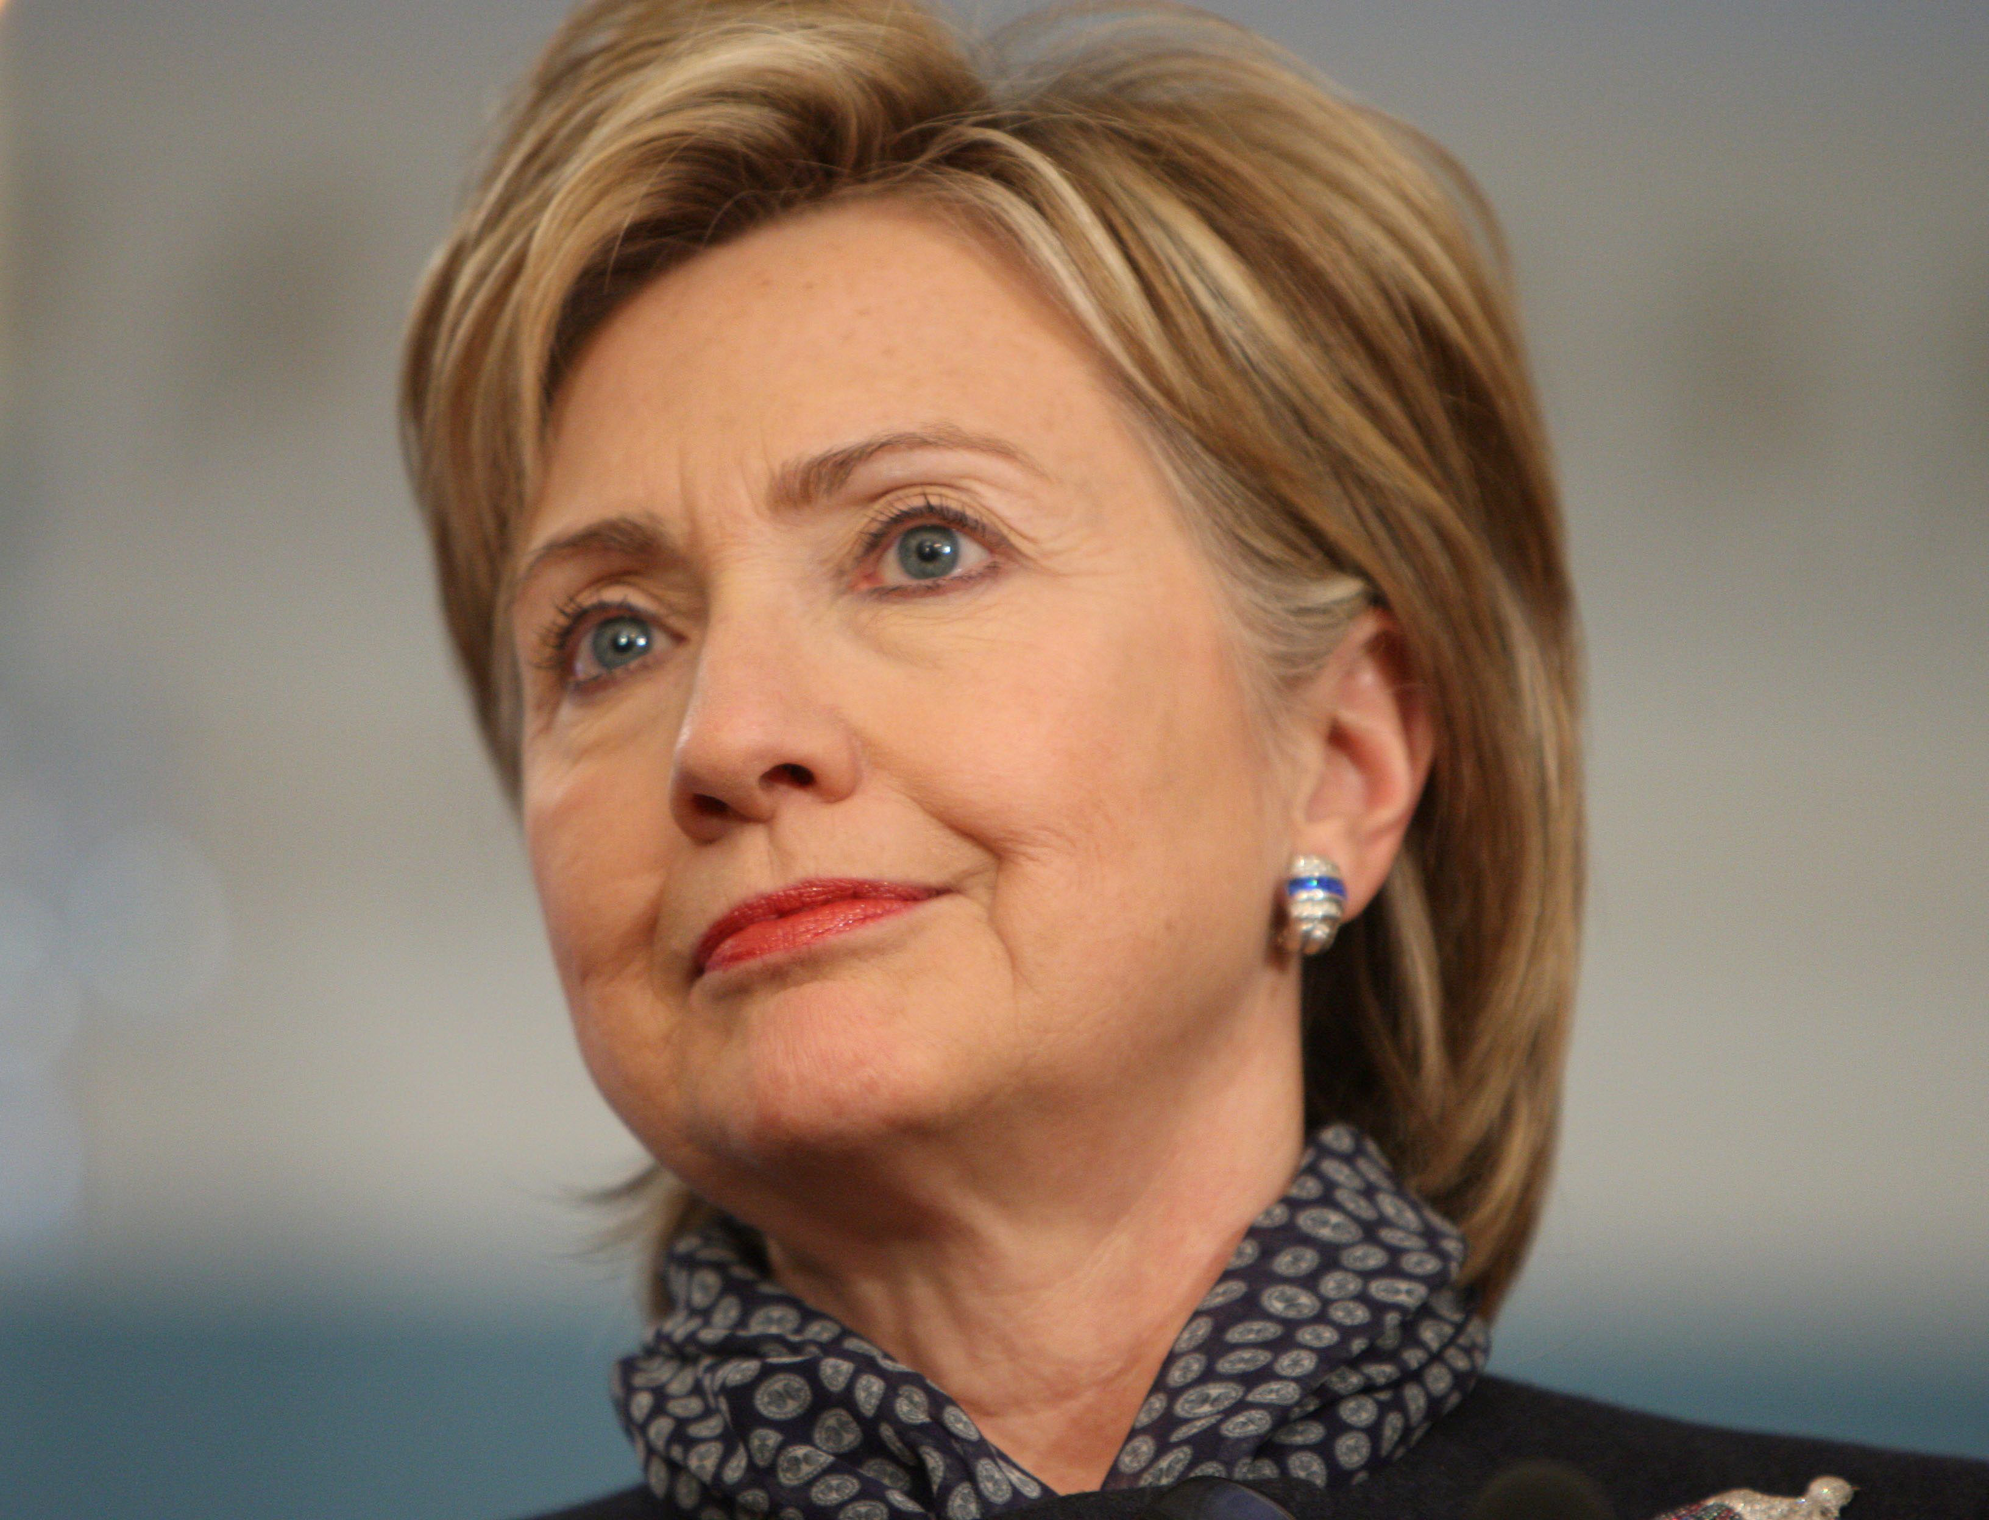
Bipartisan research on safety cases must continue after the election
This work will Make America Great Again
I agree completely

